Slide 1
Embeddedness and Dispersion in Ego Networks
EE232E
Spring 2018

Slide 2
The Paper
“Romantic Partnerships and the Dispersion of Social Ties: A Network Analysis of Relationship Status on Facebook”, Lars Backstrom, Jon Kleinberg

Slide 3


Problem Statement
Consider a social network user, $a$

Slide 4
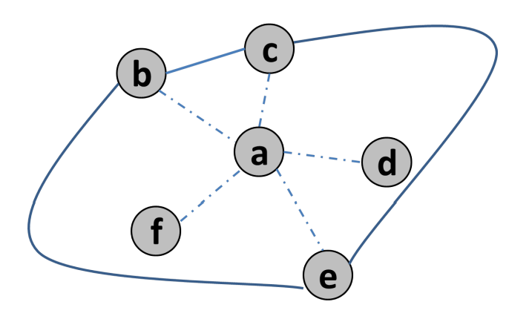

Problem Statement
Consider a social network user, $a$, and its neighborhood...

Slide 5
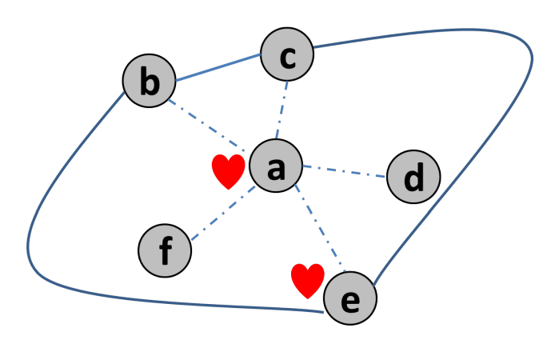

Problem Statement
Also, let us assume that $a$ is married. Can we identify his wife?

Slide 6
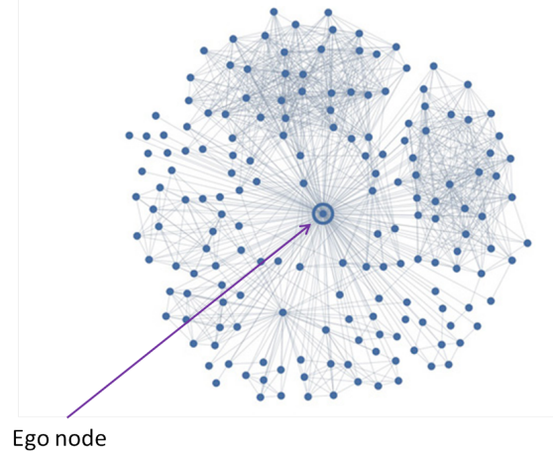
Facebook Semantics
A user is represented by a node.
Facebook’s friendship relation is undirected.
An edge between two nodes represents a friendship between the corresponding users.

Slide 7

Embeddedness
Given an edge $(u, v)$, its embeddedness is the number of mutual friends shared by its endpoints.
Traditionally, embeddedness is associated with tie strength, and will be used as a baseline predictor.

Slide 8
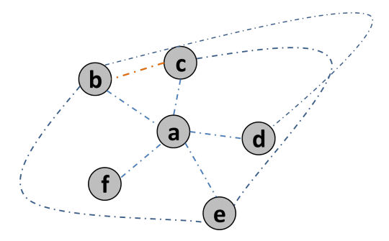

Example
$b$ and $c$

Slide 9
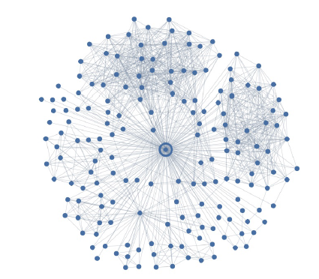
What’s Wrong with Embeddedness
Works 25% of times
Many individuals have large clusters of friends corresponding to well-defined foci of interaction in their lives:
Co-workers.
People with whom they attended college.
Family members.
Etc.
Since many people within these clusters know each other, the clusters contain links of very high embeddedness even though they do not necessarily correspond to particularly strong ties.
Co-workers
College friends

Slide 10
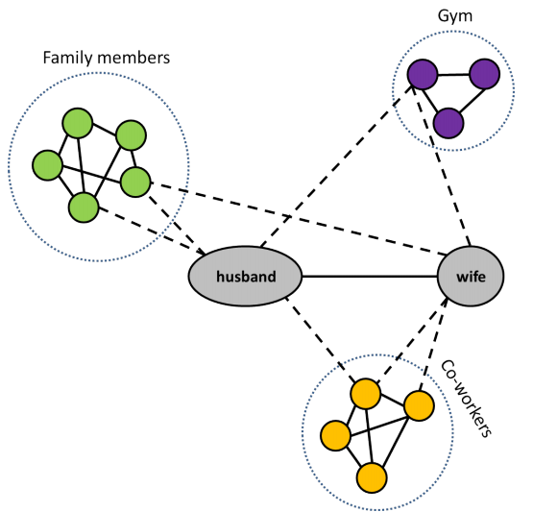
Dispersion
In contrast, the links to a person’s relationship partner may have lower embeddedness, but they will often involve mutual neighbors from several different foci, reflecting the fact that the social orbits of these friends are not bounded within any one focus.
The mutual neighbors of a married couple are not well-connected to one another.

Slide 11
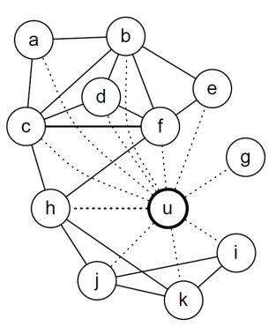
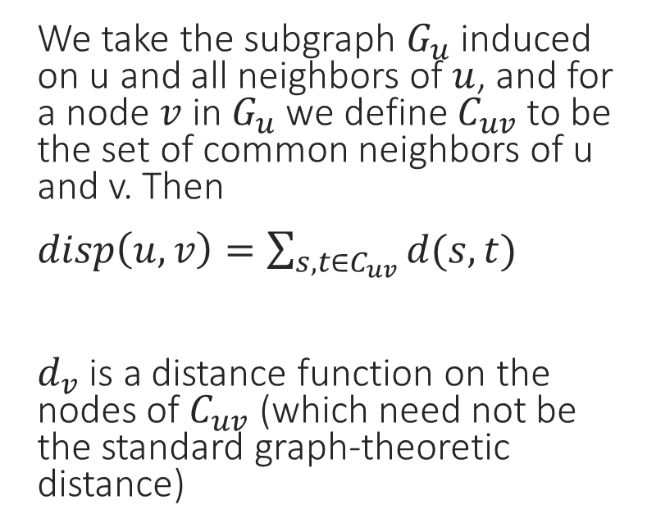
Dispersion
We take the subgraph $G_{u}$ induced on u and all neighbors of $u$, and for a node $v$ in $G_{u}$ we define $C_{uv}$ to be the set of common neighbors of u and v. Then
$disp\left(u, v\right)=\sum_{s,t∈C_{uv}}{d(s,t)}$
$d_{v}$ is a distance function on the nodes of $C_{uv}$ (which need not be the standard graph-theoretic distance)

Slide 12

Options for the Distance Function
A distance threshold $r$ over $G_{u}−\left\{u,v\right\}$
$1$
$1<r<∞$
$∞$
Divide $G_{u}−\left\{u\right\}$ into communities
Embed $G_{u}−\{u\}$ in the plane using energy-minimization

Slide 13
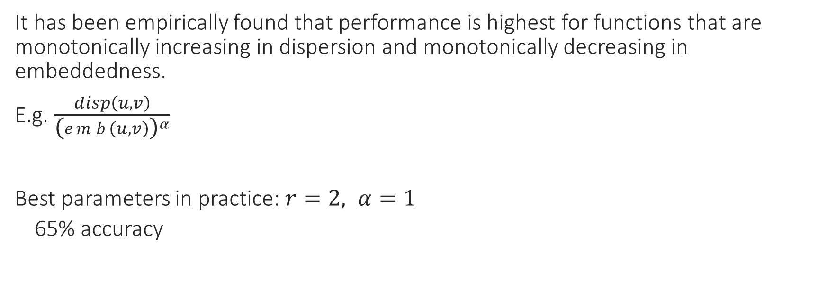
Spouse Detection
It has been empirically found that performance is highest for functions that are monotonically increasing in dispersion and monotonically decreasing in embeddedness.
E.g. $\frac{disp\left(u, v\right)}{{\text{(}emb\left(u, v\right)\text{)}}^{α}}$
Best parameters in practice: $r=2, α=1$
65% accuracy

